Slide 1
Management system
E-Commerce Store

Slide 2
Group Members
Raheel khan
Altaf Hussain

Slide 3

Why We Choose This:
User-Friendly Interface: Designed for ease of use, ensuring smooth navigation for both admins and customers
Efficient Product Management: Simplifies inventory, order tracking, and data analysis for administrators.
Seamless Shopping Experience: Provides intuitive browsing, secure payments, and real-time order updates for customers.
Simplicity and Functionality: Combines essential features with a clean design to maximize efficiency and satisfaction.

Slide 4

Introduction:
A system to streamline shopping for
admins and customers.
Functionalities:Admin:
Manage inventory, orders, and
analytics.
Customer:
Browse, shop, and track orders.
Why It Matters:
Automates processes for efficiency.
Enhances user experience with intuitive features.
Scales to meet growing e-commerce demands.

Slide 5
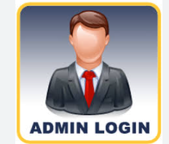
Admin Login Functionality:
Role: The admin is responsible for managing the store's products and inventory efficiently.
Key Features:
View All Products: Easily access and monitor the complete product list.
Add New Products: Introduce new items to the inventory with detailed information.
Update Product Information: Edit product details such as price, description, and availability.
Delete Products: Remove outdated or discontinued items from the store.
Secure Login: Access is protected with predefined credentials to ensure system security.

Slide 6
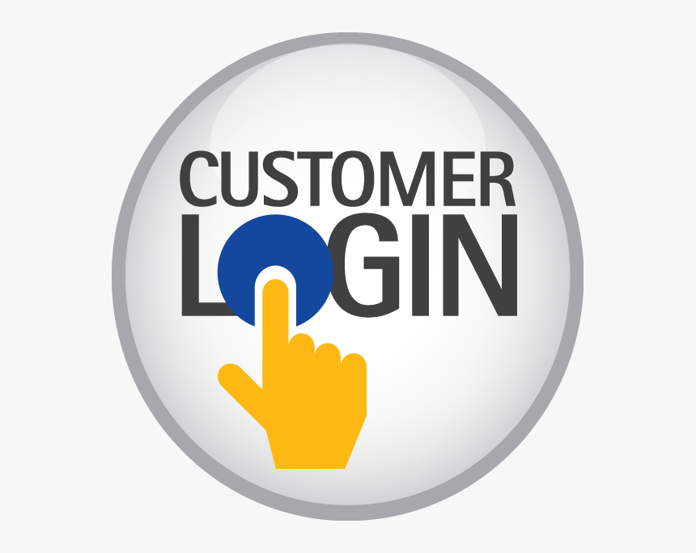
Customer login
Role: The customer can browse the store and manage their shopping cart for a seamless shopping experience.
Key Features:
View Product Catalog: Browse through a wide range of products available for purchase.
Search for Product Details: Easily find products by searching for detailed information, including descriptions, prices, and availability.
Add Products to Cart: Select and add desired items to the shopping cart for checkout.
View and Manage Cart: Review selected items, modify quantities, or remove products before purchase.
Secure Login: Customers log in with predefined credentials to ensure privacy and security.

Slide 7

Key Features of the System
Product Management for Admins (CRUD Operations):
Admins can efficiently manage the product inventory with the ability to create, read, update, and delete products as needed to keep the catalog up-to-date.
Customer Cart Management:
Customers can easily add or remove products from their shopping carts, ensuring a smooth and flexible shopping experience.
Dual Login System:
A secure login system differentiates between admin and customer roles, providing access to specific features based on user type.
User-Friendly Interface:
The system offers clear and simple options for both admins and customers, making navigation and task management easy for all users, regardless of their technical expertise.

Slide 8

Real-World Applications
Perfect for Growing Businesses:
This system is designed to scale, making it ideal for small to medium-sized e-commerce businesses looking to optimize operations and enhance customer experience.
Adaptable Across Industries:
Whether you’re in electronics, clothing, accessories, or other sectors, the system can be easily tailored to meet the specific needs of various industries, ensuring versatility.
Great for Entrepreneurs:
If you're starting your e-commerce journey, this system provides a robust yet simple platform to manage your store efficiently, allowing you to focus on growth and customer satisfaction.

Slide 9

How It Helps People
For Admins:
Simplifies Inventory Management: Easily track and manage product stock, update details, and maintain an organized inventory without complex systems.
Reduces Operational Workload: Automates tasks such as order processing and product updates, allowing admins to focus on higher-priority business needs and decision-making.
For Customers:
Streamlined Shopping Experience: Provides a smooth, intuitive interface that simplifies product browsing, selection, and checkout processes.
Quick and Easy Access to Product Information: Customers can easily find detailed product descriptions, prices, and availability, making their shopping journey faster and more informed.

Slide 10

Benefits of This System
Increases Operational Efficiency: Automates key processes like inventory tracking, order management, and customer interactions, which helps reduce manual work, improves speed, and boosts overall business performance.
Enhances Customer Satisfaction: With a user-friendly interface, secure payment options, and fast checkout, customers enjoy a smooth and enjoyable shopping experience, leading to higher satisfaction and loyalty.
Easy to Scale and Integrate: The system is designed to grow with your business. As your e-commerce store expands, you can easily add new features, integrate with third-party tools, and accommodate an increasing number of customers and products.
Encourages Better Resource Management: Streamlines product management, reduces inventory errors, and optimizes workload distribution, ensuring your business runs efficiently and makes the most of available resources.

Slide 11

Future of This Store Management System
Integration of Payment Gateways: Enable secure online transactions directly within the system.
Personalized User Accounts:
Allow users to register and save preferences for a tailored shopping experience.
Real-Time Inventory Updates:
Sync inventory to reflect stock levels instantly, ensuring accuracy.
Mobile Application:
Develop a mobile-friendly version to enhance accessibility.
AI-Powered Recommendations:
Implement AI to suggest products based on user behavior and preferences.

Slide 12

Conclusion
Enhanced Productivity:
Automation of key processes for both admins and customers boosts operational efficiency, reduces errors, and frees up time for growth-focused tasks.
Seamless Shopping Experience:
A user-friendly interface ensures customers can easily navigate the store, find products, and complete their purchases quickly and securely.
Scalable Design:
Designed to grow with your business, the system can be customized and expanded with advanced features, integrations, and additional resources as your business evolves.

Slide 13

QUESTIONS
Feel free to ask if you have any questions
Thank You!

